Slide 1
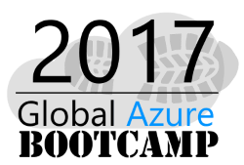
Microservices and docker
Dave Milner

Slide 2
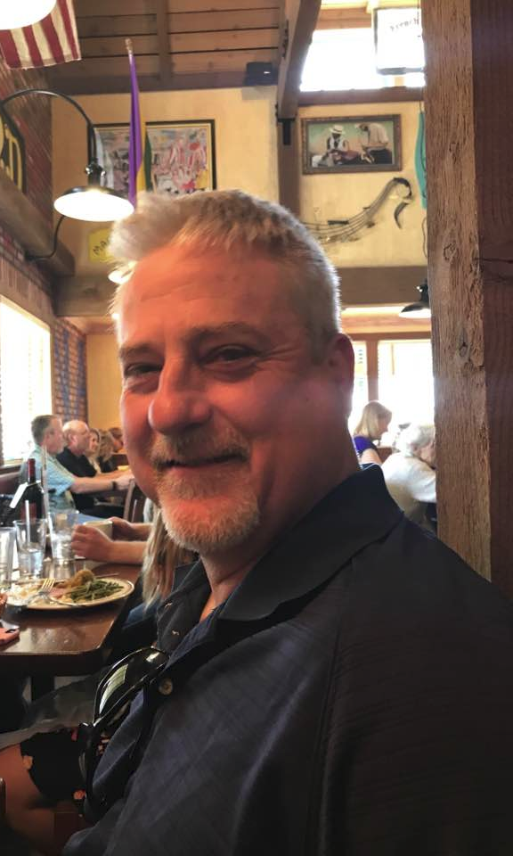
Dave Milner - Phidiax
Sr. Collaboration & Cloud Architect
Background
SharePoint and Office 365
.NET development
JavaScript development
Current Focus
Cloud / Azure
Open Source
DevOps

Slide 3
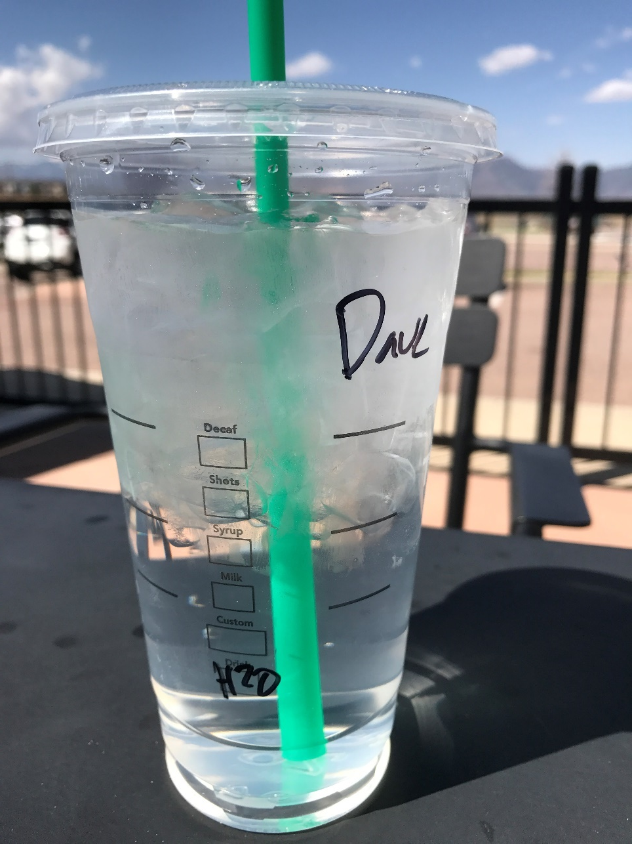
H2O for Life
Open source project
https://github.com/davemilner/h2oforlife
Background
Dev Junkyards
Personal injury
Water consumption monitoring
Focus
Water consumption tracking
Demos – toward this effort
Open source
Conversation
Get Involved

Slide 4

Agenda
Microservices
Docker
Purpose
Introduce to Trend
Advances in Tools
Visual Studio 2017 / Code
Azure
Notes:
Pretty large topics – but both of these are mostly recent developments
Microservices – pattern – earliest time term used 2012
Docker – container advancement – 100M initial 2013 - > 6B today
Both entities have rapid amounts of growth in a short period of time
Can’t cover all of them in entirety – narrow down focus
PURPOSE: Introduce current hot topics of microservices and containers with Docker at forefront in the industry, show some of Microsoft’s tool advancements in the space , and break it down to point to actionable steps with real examples to help you start taking advantage of the advantages to the business these technologies represent.

Slide 5



Monolithic Architecture - Old
Solution: IIS Website / .NET server side code
Extended vdir directory structure underneath
Sub “Apps”
Examples of original monolithic site architecture:

Slide 6
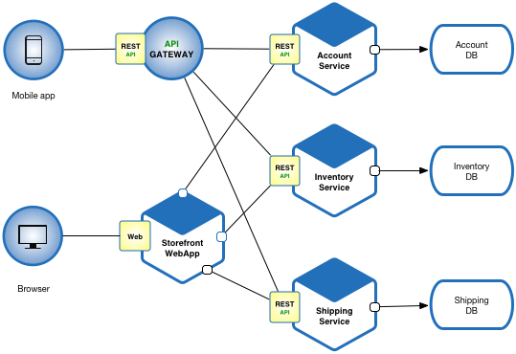
Demo
From microservices.io
Notes:
Example of Microservices diagram – newer approach
Large monolithic apps are being replaced with individual service components

Slide 7

Microservices
.NET
JavaScript / Node.js
.NET
Evolution of .NET
.NET Core
ECMAScript / Node.js
JS frameworks
TypeScript
Data layer - NoSql
Notes:
Narrowing down topic
2 approaches to Microservice development with an Azure cloud focus
NOTE: Not going to define the very broad topic of Microservices here but a brief intro. Want to get to specifics of how with demos and takeaway code
.NET developer – since 2000 – look briefly where we have come and future with containers
Front-end development is taking root with exponential use of smaller form factor devices
Node approach with ECMAscript frameworks – Angular, React, Knockout, Aurelia – some MVVM pattern, other patterns
TypeScript – Enterprise enabling open source
NoSQL – MongoDB – Azure – DocumentDB with MongoDB API offerings

Slide 8

Docker
Container Advancements
Orchestrators
Visual Studio 2017 and Docker
Integrated Docker support
Azure Deployment
Azure and Docker
Azure Container Registry
Windows Server 2016 / IaaS
Notes:
Docker Con 2017 this last week – huge advancements
SwarmKit – orchestrator tooling – security and deployment of docker containers
linuxKit – pared down optimized container that can be used on all OS – mac, Windows, Linux
InfraKit and containerD
Moby Kit – open source – mobyproject.org
Common orchestrator future
Containers in general – Kubernetes – open source containers – MS acquisition last week – Deis orchestrator tooling for kubernetes containers
Spend some time especially in demos highlighting Visual Studio 2017 Release and support for Docker. Visual Code support also for Docker.

Slide 9

Microservices - Evolution of .NET
C#
1.0 - Managed Code
2.0 – Generics, Anon Delegates
3.0 – LINQ
4.0 – Dynamic typing
IIS
ASP.NET
Windows Server
.NET (5.0) Core 1.0+
Cross-platform
Remove dependency on OS stack – ASP.NET Core
Intersection of Container and Dev
.NET Standard
DevOps
Notes:
Microsoft Development Tools – NOTE: long slide

Slide 10

JavaScript
ECMA
TypeScript
Frameworks
Open Source
NoSQL
MongoDB
DocumentDB
Azure
Container support
Notes:
Container size – VM’s are huge – 2.4GB usually min VM containers are ~multi GB
For .NET MVC deployment – see later – 288MB – Docker containers ~hundred MB – easily 1/10 size
Better utilization of resources

Slide 11

Both Pillars
.NET Core WebAPI
JavaScript Front End
Resources
https://github.com/aspnet/javascriptservices
Skeleton project for both pillars
Dual bootstrap
Yeoman templates
React
React w/Redux
Angular
Aurelia
Knockout
Notes:
Microsoft Development Tools

Slide 12

Demo
Notes:
Microsoft Development Tools

Slide 13

Container Advancements
Size - down
Deployment Times – down
Orchestrators – more capable
IAAS -> PAAS
Containers
IAAS->CAAS
IAAS-> CAAS ->PAAS
Continuous Delivery
DevOps
Notes:
Container size – VM’s are huge – 2.4GB usually min VM containers are ~multi GB
For .NET MVC deployment – see later – 288MB – Docker containers ~hundred MB – easily 1/10 size
Better utilization of resources

Slide 14

Docker
2013 - 2017
100M – 6B containers pulled
Open source – 2900 contrib.
LinuxKit
Moby
Docker Swarm
SwarmKit
InfraKit
Notes:
Container company NOTE: ½ way through slide deck
Geometrically exponential growth
International growth

Slide 15
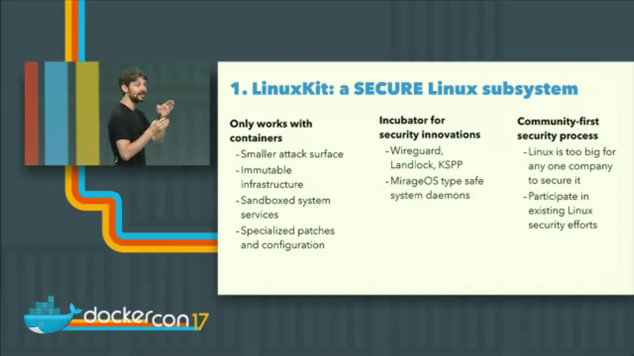
Notes:
Solomon Hykes – founder of Docker – highlighting advances in LInuxKit – scaled down OS for containers

Slide 16
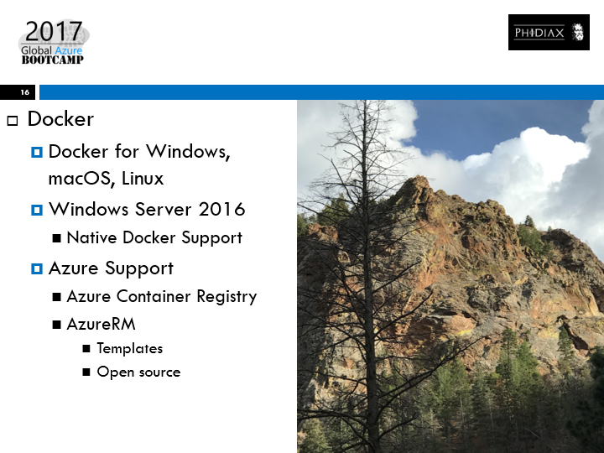
Docker
Docker for Windows, macOS, Linux
Windows Server 2016
Native Docker Support
Azure Support
Azure Container Registry
AzureRM
Templates
Open source
Notes:
Docker always cross platform
Windows Server 2016 native – bridge gap between IaaS – VM’s and PaaS – Azure hosted apps.
Caas – Container as a service – lightweight scalable transports to host code
Question –how can I possibly take advantage of a Docker Swarm for offering to my devs for improved lifecycle?

Slide 17
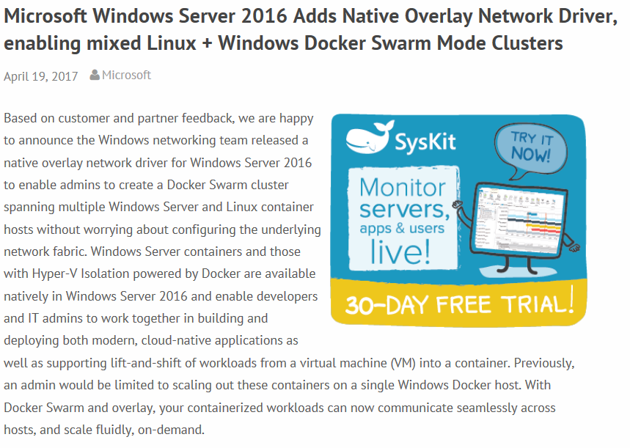
Notes:
New tools both in cloud, in OS, and in dev tooling to support containers.

Slide 18
Demo
Notes:
Microsoft Development Tools

Slide 19
Visual Studio 2017
Built-in Docker support
Add support for existing project
Azure
Publishing templates
Notes:
VS 2017 feature set launch includes direct support for this fast growing area of DevOps.
Quick personal lifecycle of developing a new Microservice in a containerized environment, then being able to publish directly to Azure to a hosted Docker image.

Slide 20
Demo
Notes:
Microsoft Development Tools

Slide 21
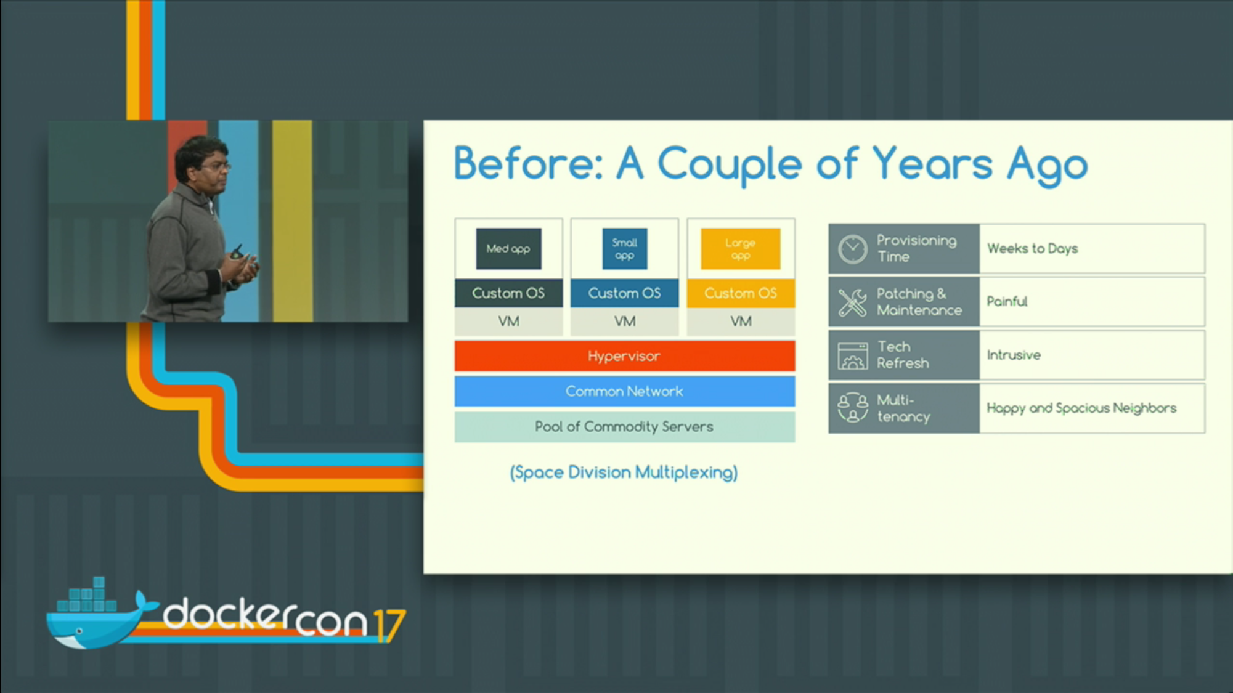
Notes:
Setup – DockerCon last week – one of the keynotes – a success story was Visa – lead architect – journey into containers from a basic virtualized environment NOTE: monitor time here
Docker Con 2017 Session – Visa Before
Migration from an IaaS virtualized infrastructure – his term “space division multiplexing”

Slide 22
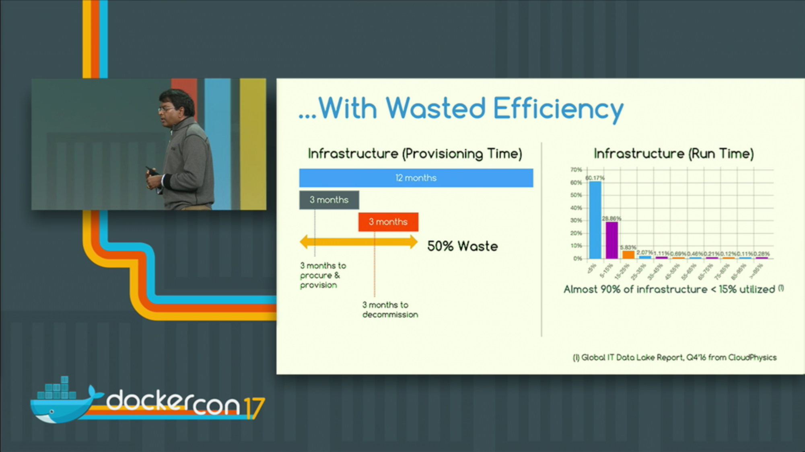
Notes:
Docker Con 2017 Session – Visa Wasted Efficiency
Problems with “Space Division Multiplexing”

Slide 23
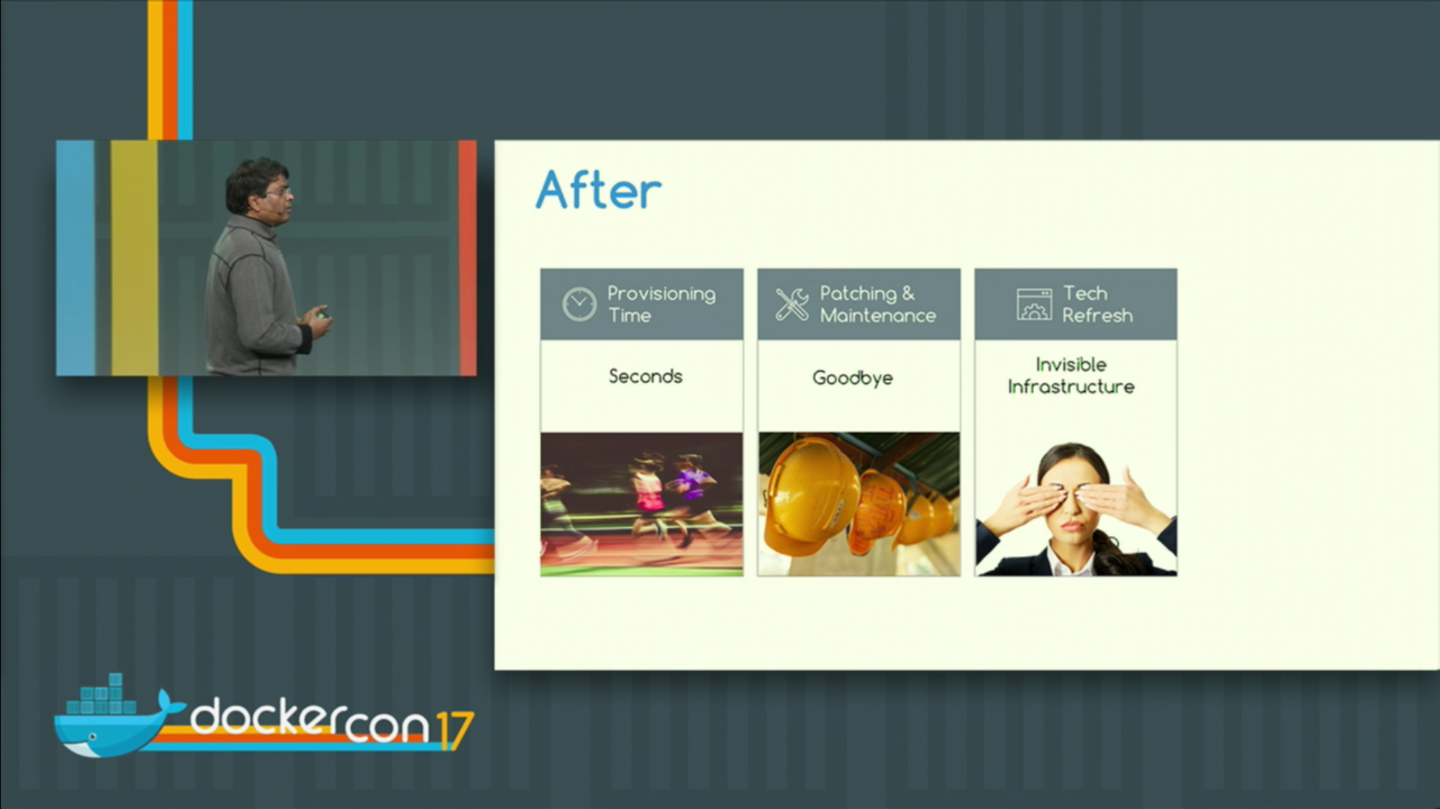
Notes:
Docker Con 2017 Session – Visa After
DevOps – partnering of Infrastructure and AppDev teams
Parting Thought – DevOps can make a HUGE difference.

Slide 24

Questions?

Slide 25
Dave Milner - Phidiax
Sr. Collaboration & Cloud Architect
Contact
Twitter @davemilner
David.Milner@Phidiax.com
Blog – www.davemilner.com
Github
https://github.com/davemilner

Slide 26
Resources
Content at Github:
https://github.com/davemilner/AzureGlobalBootcamp2017
https://github.com/davemilner/h2oforlife
eBook:
Containerized Docker Application Lifecycle With Microsoft Platform and Tools - https://www.microsoft.com/en-us/download/details.aspx?id=54266
Resources:
Docker Development with Visual Studio 2017 – Steve Lasker - https://channel9.msdn.com/Events/Visual-Studio/Visual-Studio-2017-Launch/T111
Docker Workflows with Visual Studio – Steve Lasker https://channel9.msdn.com/Events/Connect/2016/206 -
Azure Container Registry – Steve Lasker https://channel9.msdn.com/Events/Connect/2016/205 -
Deploying Containers to Azure App Services and Azure Container Service - https://channel9.msdn.com/Events/Visual-Studio/Visual-Studio-2017-Launch/T120
Continuous Integration and Deployment to Azure Container Service – John Stallo - https://channel9.msdn.com/Events/Connect/2016/204

Slide 27

Thank You!
Call to Action !!!
Take Advantage of last 4 Years of Container Advancement
Streamline Your DevOps

